Slide 1
Data Mining Cluster Analysis: Advanced Concepts and Algorithms
Lecture Notes for Chapter 9
Introduction to Data Mining
by
Tan, Steinbach, Kumar
© Tan,Steinbach, Kumar Introduction to Data Mining 4/18/2004 1

Slide 2
Review Last Session
Comparing Clustering Algorithms: K-Means versus DBSCAN

Slide 3
Graph-Based Clustering
Graph-Based clustering uses the proximity graph
Start with the proximity matrix
Consider each point as a node in a graph
Each edge between two nodes has a weight which is the proximity between the two points
Initially the proximity graph is fully connected
MIN (single-link) and MAX (complete-link) can be viewed as starting with this graph
In the simplest case, clusters are connected components in the graph.

Slide 4
Graph Representation
We can represent the relationships between data points in a graph.

Slide 5
Graph Representation
We can represent the relationships between data points in a graph.
Weight the edges by the similarity between points

Slide 6
Representing data in a graph
How to compute the similarity between two data points?
Distance based:

Slide 7
Graphs
Nodes and Edges
Edges can be directed or undirected
Edges can have weights associated with them

Slide 8
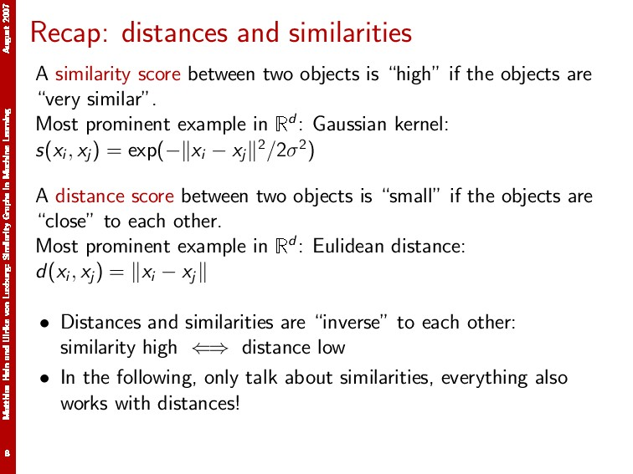
Matthias Hein and Ulrike von Luxburg August 2007

Slide 9
Graph Examples - Distance
node | Height | Weight
A | 20 | 5
B | 8 | 6
C | 9 | 4
D | 4 | 4
E | 4 | 5
E
4.1
5.1
B
1
12
4.5
2.2
D
5
11
A
C

Slide 10
Graph Examples - Similarity
node | Height | Weight
A | 20 | 5
B | 8 | 6
C | 9 | 4
D | 4 | 4
E | 4 | 5
E
.24
.19
B
1
.08
.22
.45
D
.2
.09
A
C

Slide 11
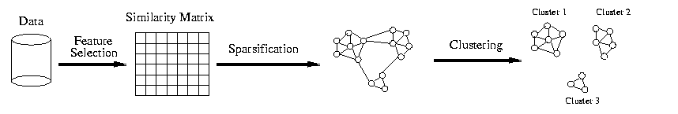
Graph Clustering

Slide 12


Some Terminology
Degree
Volume of a set

Slide 13

Graph Cuts
The cut between two subgraphs is calculated as follows

Slide 14

Intuition
The minimum cut of a graph identifies an optimal partitioning of the data.
Recursively partition the data set
Identify the minimum cut
Remove edges
Repeat until k clusters are identified

Slide 15
Computational Complexity
Minimum Cut: Hao and Orlin, 1994. For a graph G = (V, E), finding the minimum cut can be done in O(|V|×|E| log(|V|²/|E|)).
Maximum Cut: NP-hard

Slide 16
Graph Partition Problem (GPP)
Let G(V, E) be an undirected connected graph.
Un-/ weighted GPP: Partition V into k (>1) subsets V₁, V₂, ..., V_{k} such that the parts are disjoint and have equal size, and the number/weight of edges with endpoints in different subsets is minimized.
Bad news: The un-/ weighted GPP is NP-hard.

Slide 17
K-Cut Problem
Let G = (V, E) be an undirected weighted and connected. An edge set A ⊆ E is called a k-cut if G′ = (V,E \ A) has k connected components.
K-cut Problem: Compute a minimum weight k-cut in G.
Bad news: The k-cut problem is NP-hard.

Slide 18
Sparsification during Graph Clustering
Sparsification reduces the amount of data that needs to be processed drastically:
Often more than 99% of the entries in a proximity matrix are eliminated
The amount of time required to cluster the data is drastically reduced
The size of the problems that can be handled is increased
It facilitates graph partitioning algorithms.
Chameleon and Hypergraph-based Clustering

Slide 19
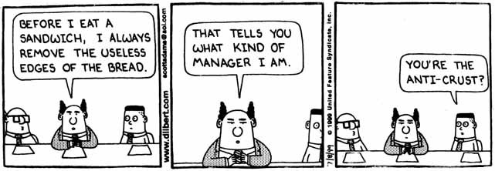
Advantages of Sparsification
Clustering may work better because
Min-Cut algorithm is faster
Only the most similar (nearest) neighbors are kept:
The nearest neighbors tend to belong to the same class.
Impact of noise and outliers is reduced.

Slide 20

Graph Cuts
Minimum (bipartitional) cut

Slide 21
Graph Cuts
Minimum (bipartitional) cut
Unnormalized cuts are attracted to outliers.

Slide 22
Graph Cuts
Minimal (bipartitional) normalized cut.

Slide 23
Spectral Clustering Example
Minimum Cut
Height | Weight
20 | 5
8 | 6
9 | 4
4 | 4
4 | 5
E
.24
.19
B
1
.08
.22
.45
D
.2
.09
A
C

Slide 24

Spectral Clustering Example
Normalized Minimum Cut
Height | Weight
20 | 5
8 | 6
9 | 4
4 | 4
4 | 5
E
.24
.19
B
1
.08
.22
.45
D
.2
.09
A
C

Slide 25
Spectral Clustering Example
Normalized Minimum Cut
Height | Weight
20 | 5
8 | 6
9 | 4
4 | 4
4 | 5
E
.24
.19
B
1
.08
.22
.45
D
.2
.09
A
C

Slide 26
More Graph Definitions
Fully connected
Insert an edge between every pair of nodes.
ε-neighborhood graph ←sparsification
Identify a threshold value, ε, and include edges if the affinity between two points is greater than ε.
k-nearest neighbors ←sparsification
Insert edges between a node and its k-nearest neighbors.
Each node will be connected to (at least) k nodes.

Slide 27
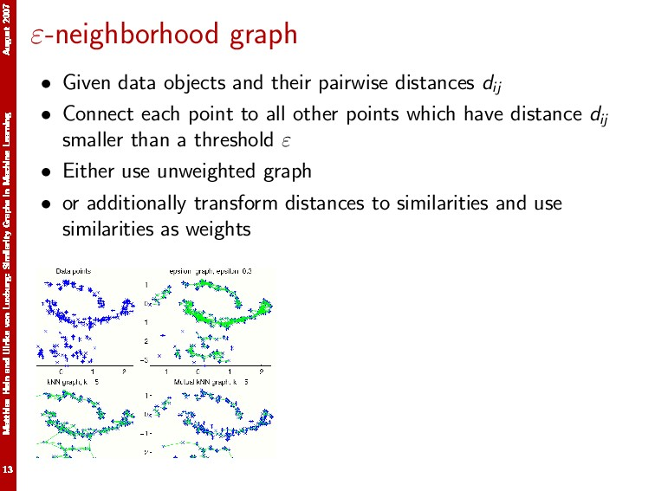
Matthias Hein and Ulrike von Luxburg August 2007

Slide 28
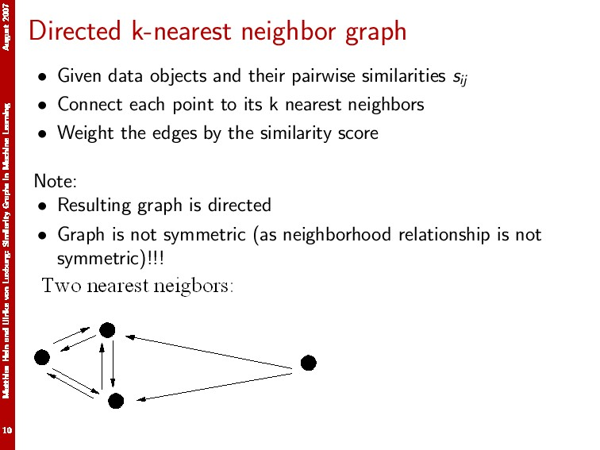
Matthias Hein and Ulrike von Luxburg August 2007

Slide 29
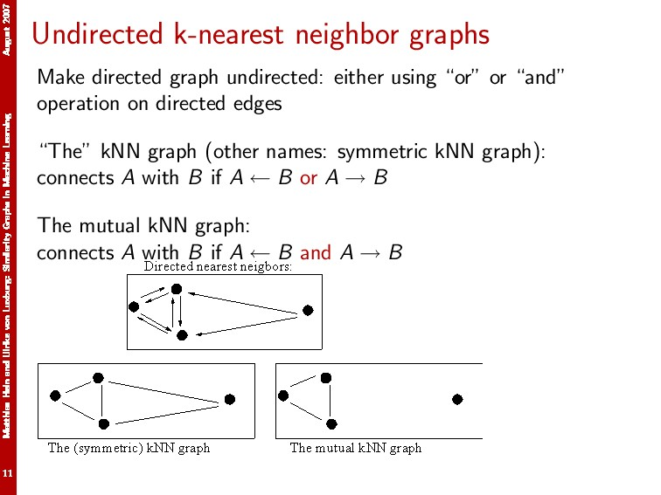
Matthias Hein and Ulrike von Luxburg August 2007

Slide 30
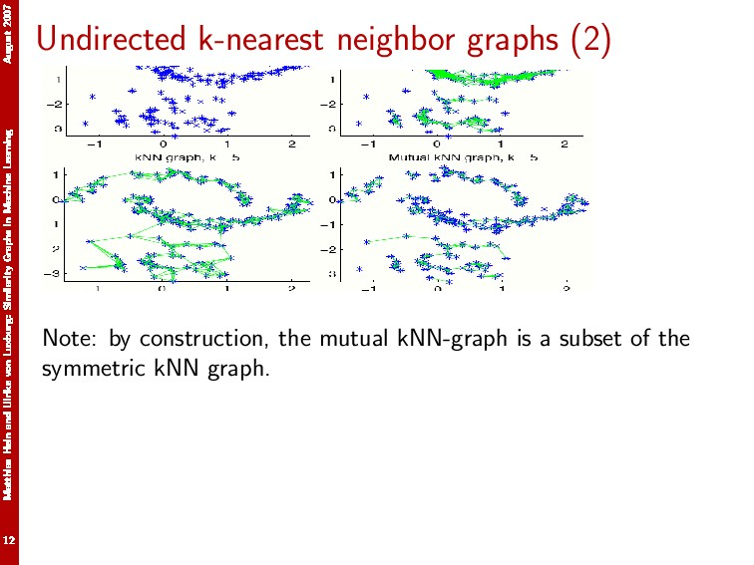
Matthias Hein and Ulrike von Luxburg August 2007

Slide 31
Shared Near Neighbor Approach
Start with ε-neighborhood graph or kNN graph.
SNN graph: the weight of an edge is the number of shared neighbors between vertices given that the vertices are connected
i
j
i
j
4

Slide 32
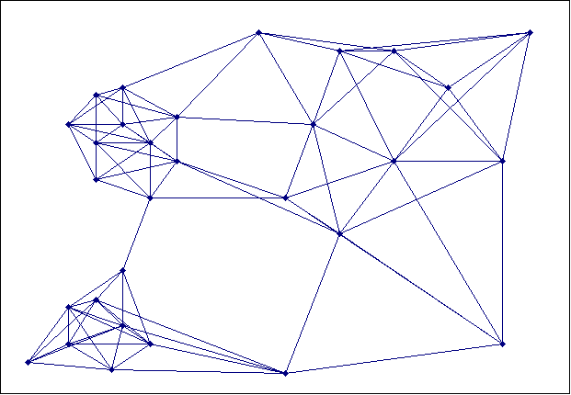
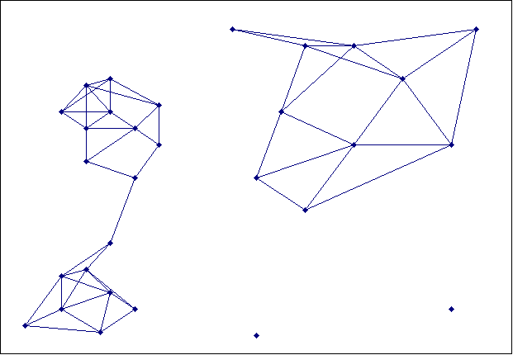
Creating the SNN Graph
Sparse Graph
Link weights are similarities between neighboring points
Shared Near Neighbor Graph
Link weights are number of Shared Nearest Neighbors

Slide 33
Jarvis-Patrick Clustering
First, the J-nearest neighbors of all points are found
In graph terms this can be regarded as breaking all but the J strongest links from a point to other points in the proximity graph
A pair of points is put in the same cluster if
the two points are in each others J nearest neighbor list
any two points share more than K neighbors and
For instance, we might choose a nearest neighbor list of size J=3 and put points in the same cluster if they share K=2 or more neighbors

Slide 34
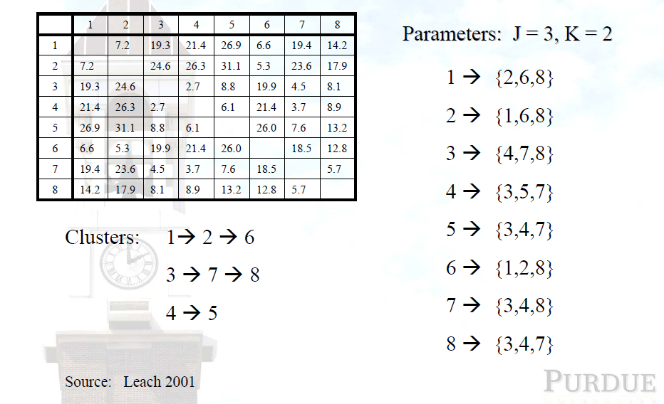
Jarvis-Patrick Example

Slide 35
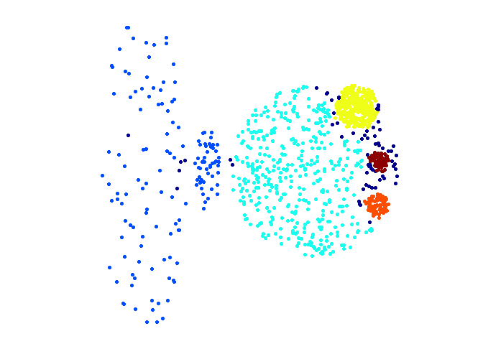
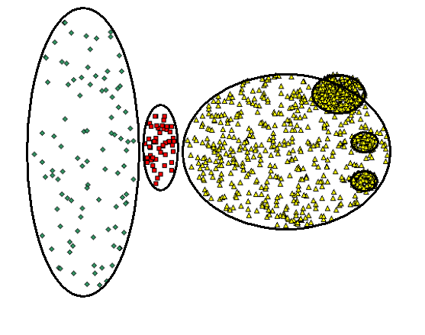
When Jarvis-Patrick Works Reasonably Well
Original Points
Jarvis Patrick Clustering
6 shared neighbors out of 20

Slide 36
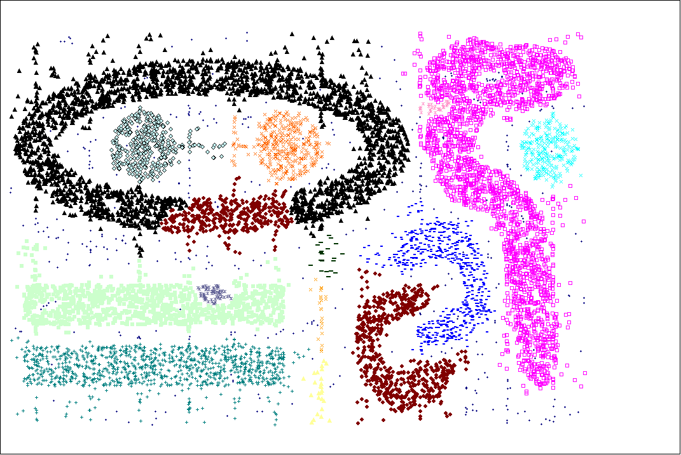
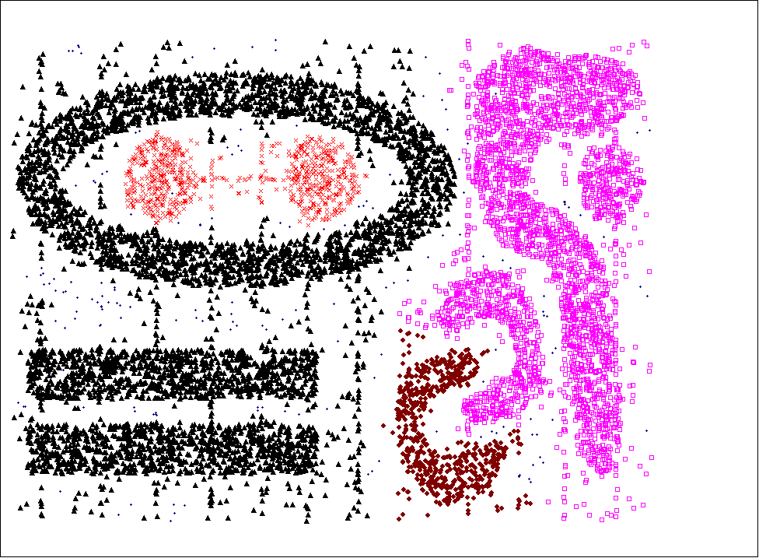
When Jarvis-Patrick Does NOT Work Well
Smallest threshold, T, that does not merge clusters.
Threshold of T - 1

Slide 37
SNN Clustering Algorithm
Basic idea:
Compute SNN similarity graph
Apply DBSCAN

Slide 38
SNN Clustering Algorithm
In more details: Compute SNN similarity graph
Compute the similarity graph. This corresponds to a similarity graph with data points for nodes and edges whose weights are the similarities between data points.
Sparsify the similarity graph. Keeping only the k most similar connections of each edge.
Construct SNN similarity graph. At this point, we could apply a similarity threshold and find the connected components to obtain the clusters (Jarvis-Patrick algorithm).

Slide 39
SNN Clustering Algorithm cont’d
In more details: apply DBSCAN
Find SNN density of each Point. Use user provided parameter, Eps, to compute the number points that have an SNN similarity of Eps or greater to a point.
Find the core points. Use a user specified parameter, MinPts, to find the core points, i.e., all points that have an SNN density greater than MinPts.
Form clusters from the core points. If two core points are within a radius, Eps, of each other they are place in the same cluster.
Discard all noise points. All non-core points that are not within a radius of Eps of a core point are discarded.
Assign all non-noise, non-core points to clusters. This can be done by assigning such points to the nearest core point.

Slide 40
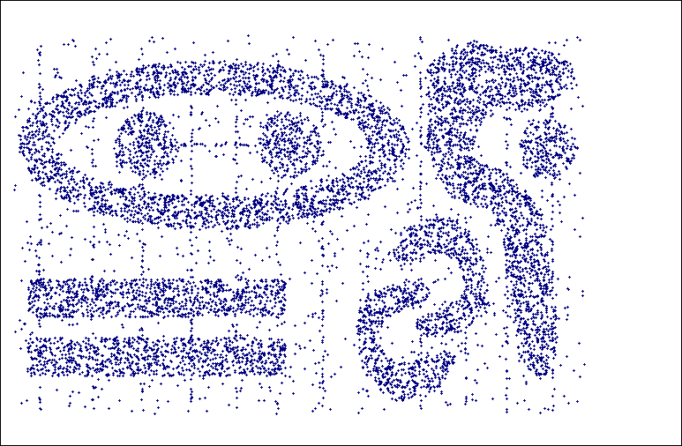
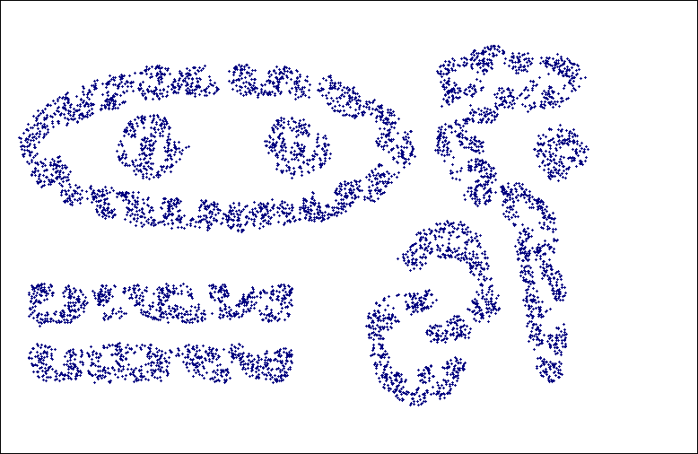
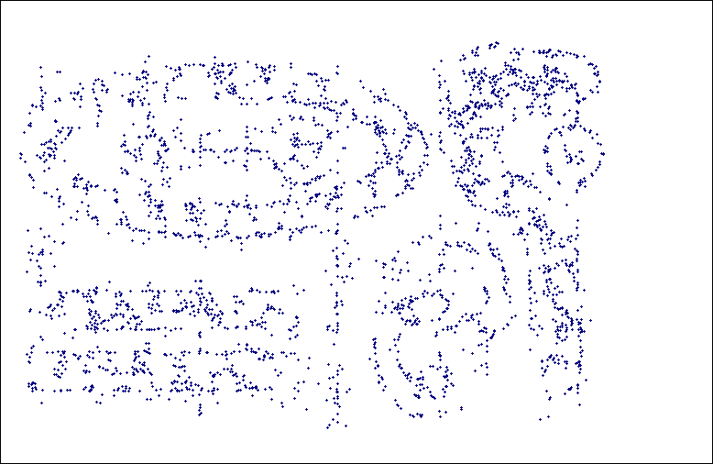
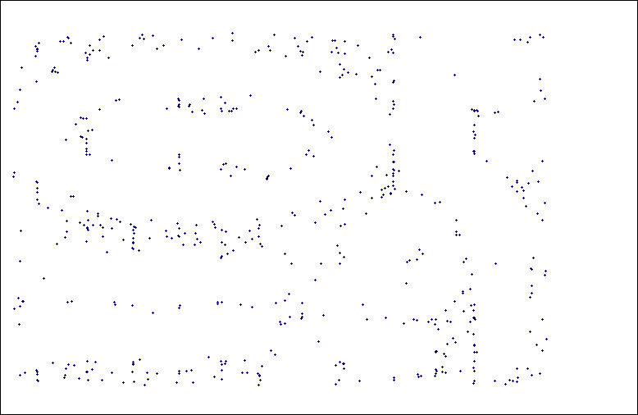
SNN Density
a) All Points b) High SNN Density
c) Medium SNN Density d) Low SNN Density

Slide 41
SNN Density
core points
a) All Points b) High SNN Density
noise points &
porder points
c) Medium SNN Density d) Low SNN Density

Slide 42
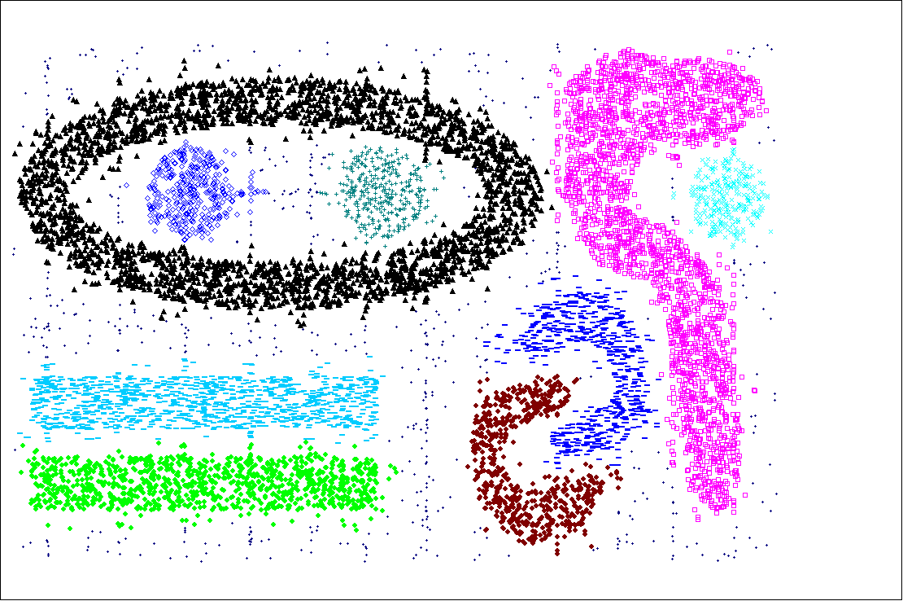
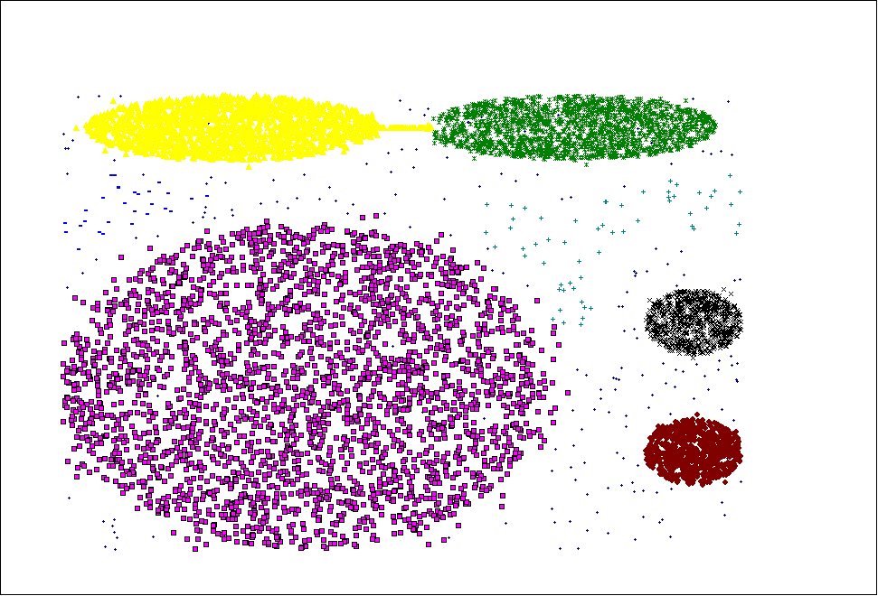
SNN Clustering Can Handle Other Difficult Situations

Slide 43
Finding Clusters of Time Series In Spatio-Temporal Data
SNN Clusters of pressure time series
SNN Density of Points on the Globe.

Slide 44
SNN Clustering Can Handle Differing Densities
Original Points
SNN Clustering

Slide 45
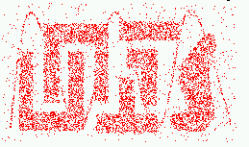
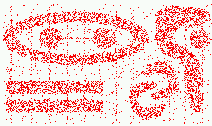
Characteristics of Spatial Data Sets
Clusters are defined as densely populated regions of the space
Clusters have arbitrary shapes, orientation, and non-uniform sizes
Difference in densities across clusters and variation in density within clusters
Existence of special artifacts (streaks) and noise
The clustering algorithm must address the above characteristics and also require minimal supervision.

Slide 46
Features and Limitations of SNN Clustering
Does not cluster all the points
Complexity of SNN Clustering is high
O( n * time to find numbers of neighbor within Eps)
In worst case, this is O(n²)
For lower dimensions, there are more efficient ways to find the nearest neighbors
R* Tree
k-d Trees

Slide 47

Thank You!

Slide 48
Fuzzy Clustering
Definition: Given data points X = {x₁, …, x_{m}}. A fuzzy clustering C₁, …, C_{k} is an assignment of cluster membership weights ω_{ij} between 0 and 1 such that

Slide 49
Fuzzy C-Means Clustering
select initial fuzzy-partition
repeat
compute centroid
update fuzzy partition
until: centroids don’t change or stopping criterion fullfilled

Slide 50
Fuzzy C-Means Clustering

